Slide 1

Open API Specification Basics
Learn Swagger and the Open API Specification
Defining Simple Requests

Slide 2
Introduction
Covers
What applies to the entire API
What applies to a simple request
Path, method, query and path parameters, headers
Using the Swagger editor

Slide 3
Open API Specification File
Choose an example and build a file
Company: example.com
Service for uploading and sharing photos
API base URL:
https://api.example.com/photo

Slide 4
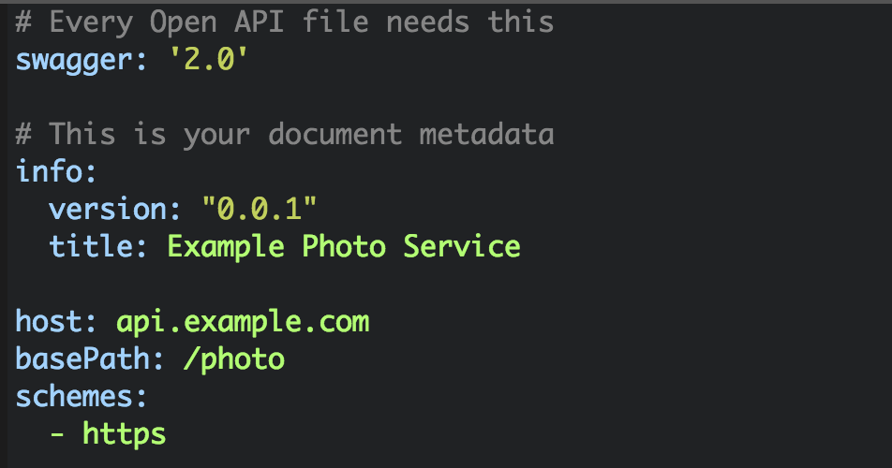
Example

Slide 5
Adding a Request
Let’s define requests for getting photo albums
Requests will have:
URL endpoint
HTTP Method
Path parameters
Query parameters
Also (covered later):
Request body
Responses

Slide 6
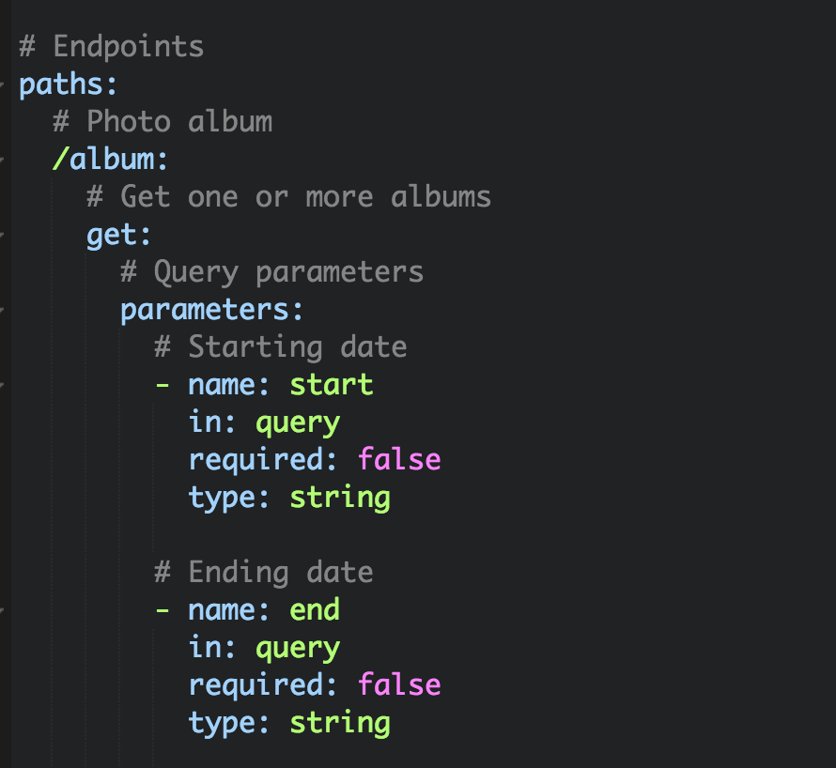
Example with query parameters
GET https://api.example.com/photo/album?start=2017-09-01&end=2017-09-31

Slide 7
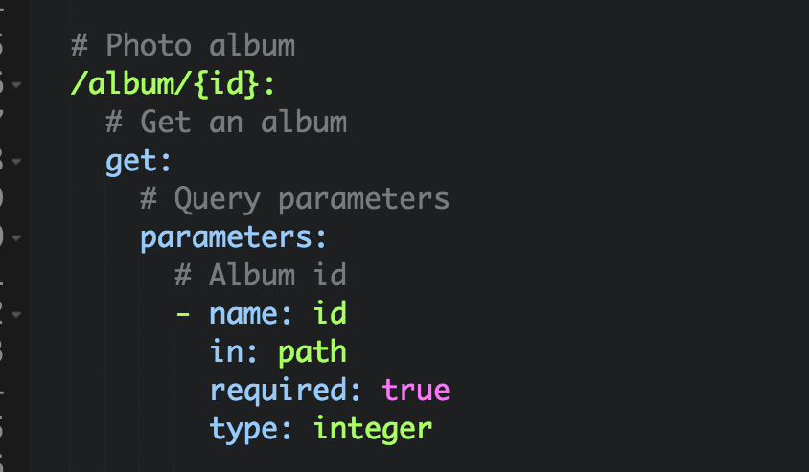
Example with path parameter
GET https://api.example.com/photo/album/123456

Slide 8
Data types
The data type can have several values
Includes:
boolean
integer
number
string
array

Slide 9
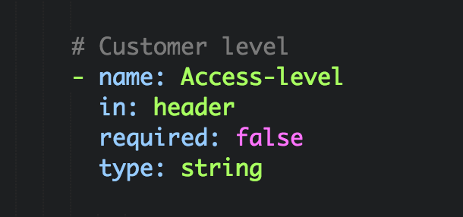
Custom headers
Custom headers are treated as parameters
Standard headers (authorization, content format) are handled elsewhere

Slide 10
Documentation
Documentation is added using the description key
I will talk about this later in the course

Slide 11
Swagger Editor
Swagger provides an editor for Open API Specification files
Go to http://editor2.swagger.io

